Slide 1

AI-Driven Exploration and Prediction of Company Registration Trends with Registrar of Companies (RoC)
DONE BY
S.NITHYASREE(113321106063)
SWEDHA.V(113321106104)
TRISHA.N(113321106109)
PERUGU VINITHA(113321106701)

Slide 2
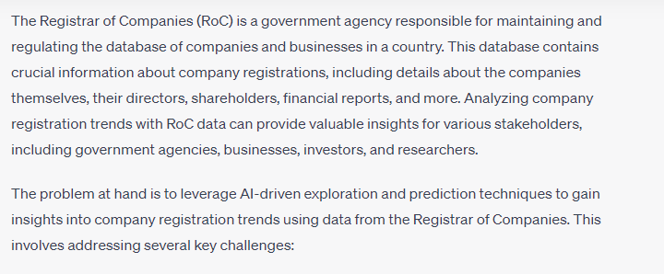
PROBLEM DEFINITION

Slide 3
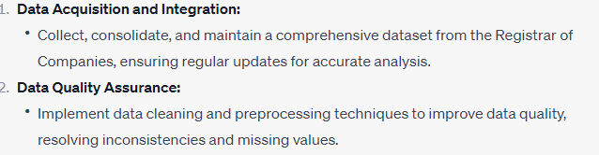
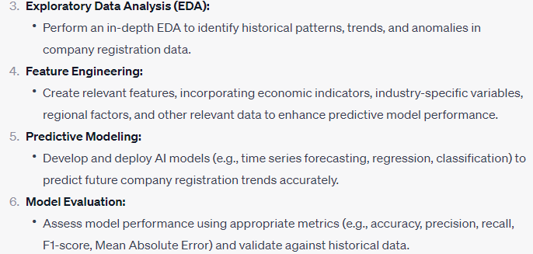
OBJECTIVES

Slide 4
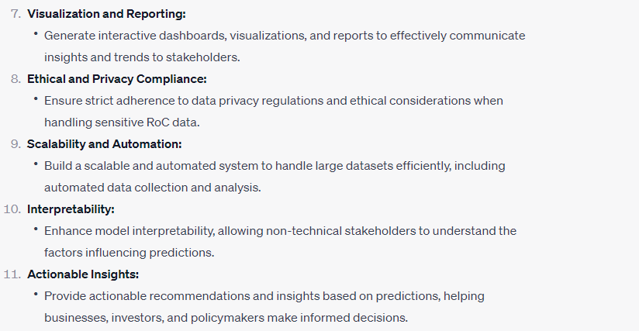

Slide 5
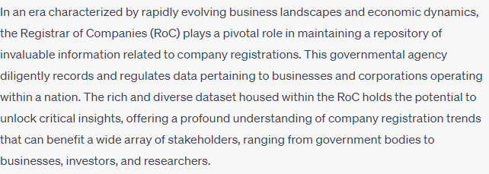
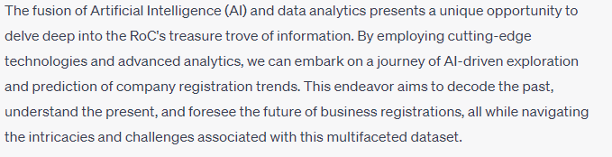
INTRODUCTION

Slide 6
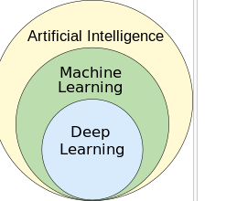
ARTIFICIAL INTELLEGIANCE

Slide 7
Objectives for AI-Driven Exploration and Prediction of Company Registration Trends with Registrar of Companies (RoC):
Data Acquisition and Integration:
Collect, consolidate, and maintain a comprehensive dataset from the Registrar of Companies, ensuring regular updates for accurate analysis.
Data Quality Assurance:
Implement data cleaning and preprocessing techniques to improve data quality, resolving inconsistencies and missing values.
Exploratory Data Analysis (EDA):
Perform an in-depth EDA to identify historical patterns, trends, and anomalies in company registration data.
Feature Engineering:
Create relevant features, incorporating economic indicators, industry-specific variables,

Slide 8
Predictive Modeling:
Develop and deploy AI models (e.g., time series forecasting, regression, classification) to predict future company registration trends accurately.
Model Evaluation:
Assess model performance using appropriate metrics (e.g., accuracy, precision, recall, F1-score, Mean Absolute Error) and validate against historical data.
Visualization and Reporting:
Generate interactive dashboards, visualizations, and reports to effectively communicate insights and trends to stakeholders.
Ethical and Privacy Compliance:
Ensure strict adherence to data privacy regulations and ethical considerations when handling sensitive RoC data.

